Slide 1




LOGO
UNIV/POLTEK
DTS 2019: Internet of Things
#26 Data Processing
digitalent.kominfo.go.id

Slide 2
Agenda
What is ThingsBoard
ThingsBoard Rule Engine
Rule Engine Node

Slide 3
What is ThingsBoard

Slide 4
What is ThingsBoard
ThingsBoard is an open-source IoT platform that enables rapid development, management and scaling of IoT projects. Our goal is to provide the out-of-the-box IoT cloud or on-premises solution that will enable server-side infrastructure for your IoT applications.

Slide 5
Features
Provision devices, assets and customers and define relations between them.
Collect and visualize data from devices and assets.
Analyze incoming telemetry and trigger alarms with complex event processing.
Control your devices using remote procedure calls (RPC).
Build work-flows based on device life-cycle event, REST API event, RPC request, etc
Design dynamic and responsive dashboards and present device or asset telemetry and insights to your customers
Enable use-case specific features using customizable rule chains.
Push device data to other systems.

Slide 6
Architecture
ThingsBoard is designed to be:
scalable: horizontally scalable platform, build using leading open-source technologies.
fault-tolerant: no single-point-of-failure, every node in the cluster is identical.
robust and efficient: single server node can handle tens or even hundreds thousands of devices depending on use-case. ThingsBoard cluster can handle millions of devices.
customizable: adding new functionality is easy with customizable widgets and rule engine nodes.
durable: never lose your data.

Slide 7
Architecture
10 000 foot view
On-premise OR cloud deployments
Standalone OR cluster mode
Monolithic OR microservices architecture
SQL OR NoSQL OR Hybrid database approach
Programming languages and third-party
https://thingsboard.io/docs/reference/

Slide 8
ThingsBoard Rule Engine

Slide 9
What is ThingsBoard Rule Engine?
Rule Engine is an easy to use framework for building event-based workflows. There are 3 main components:
Message - any incoming event. It can be an incoming data from devices, device life-cycle event, REST API event, RPC request, etc.
Rule Node - a function that is executed on an incoming message. There are many different Node types that can filter, transform or execute some action on incoming Message.
Rule Chain - nodes are connected with each other with relations, so the outbound message from rule node is sent to next connected rule nodes.

Slide 10
Typical Use Case
ThingsBoard Rule Engine is a highly customizable framework for complex event processing. Here are some common use cases that one can configure via ThingsBoard Rule Chains:
Data validation and modification for incoming telemetry or attributes before saving to the database.
Copy telemetry or attributes from devices to related assets so you can aggregate telemetry. For example data from multiple devices can be aggregated in related Asset.
Create/Update/Clear alarms based on defined conditions.
Trigger actions based on device life-cycle events. For example, create alerts if Device is Online/Offline.

Slide 11
Typical Use Case
Load additional data required for processing. For example, load temperature threshold value for a device that is defined in Device’s Customer or Tenant attribute.
Trigger REST API calls to external systems.
Send emails when complex event occurs and use attributes of other entities inside Email Template.
Take into account User preferences during event processing.
Make RPC calls based on defined condition.
Integrate with external pipelines like Kafka, Spark, AWS services, etc.

Slide 12
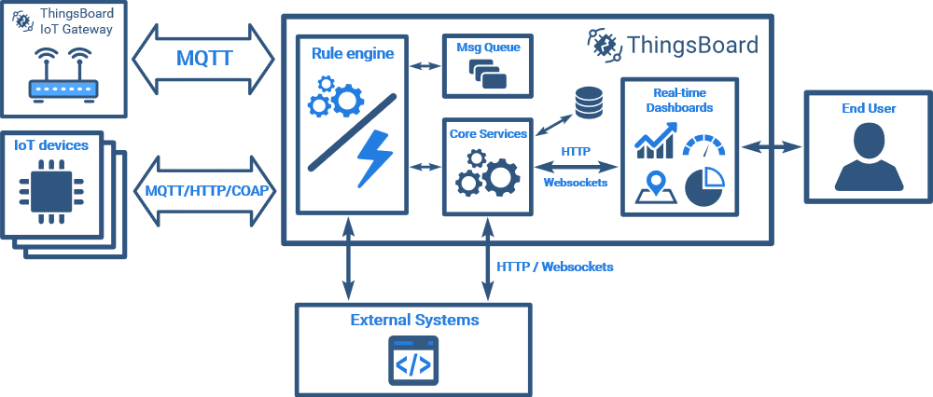
Rule Engine Architecture

Slide 13
Actor Model
Actor model enables high performance and concurrent processing of messages from device transport layer as long as server-side API calls. ThingsBoard uses Akka as an actor system implementation. There are two main actors related to the rule engine: Rule Chain Actor and Rule Node Actor.

Slide 14
Rule Chain Actor
Rule Chain actor is responsible for rule node configuration, routing messages between rule nodes, and handling queue put and ack commands.
Each Rule Chain Actor represent single rule chain configured by the user.
Rule Chain Actor is parent for multiple Rule Node actors.

Slide 15
Rule Node Actor
Rule Node actor is responsible for processing of the incoming messages.
The logic of message processing is highly customizable.
There are many built-in implementations of the RuleNodes and you can develop your own, custom rule node implementations as well.

Slide 16
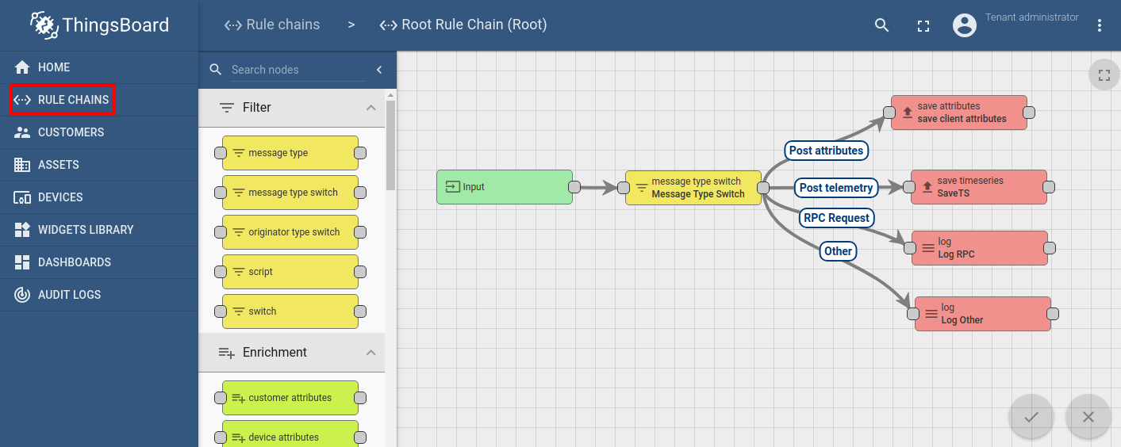
Rule Chain Example

Slide 17
Rule Engine Node

Slide 18
Filter Nodes

Slide 19
Filter Nodes
Filter Nodes are used for message filtering and routing
Check Relation Filter Node
Check Existence Fields Node
Message Type Filter Node
Message Type Switch Node
Originator Type Filter Node
Originator Type Switch Node
Script Filter Node
Switch Node
GPS Geofencing Filter Node
Fetch perimeter information from message metadata
Fetch perimeter information from node configuration

Slide 20
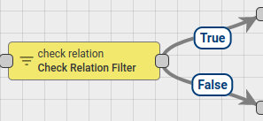
Check Relation Filter Nodes
Checks the relation from the selected entity to originator of the message by type and direction.
If relation exists - Message is sent via True chain, otherwise False chain is used.

Slide 21
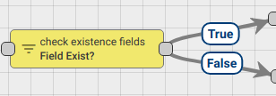
Check Existence Fields Node
Rule node checks the existence of the selected keys from incoming message data and metadata.
If selected checkbox Check that all selected keys are present and all keys in message data and metadata exists - send Message via True chain, otherwise, False chain is used.
In case that checkbox is not selected, and at least one of the keys from data or metadata of the message exists - send Message via True chain, otherwise, False chain is used.

Slide 22
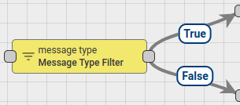
Message Type Filter Node
In the Node configuration, administrator defines set of allowed Message Types for incoming Message. There are predefined Message Types in the system, like Post attributes, Post telemetry, RPC Request, etc. An administrator can also define any Custom Message Types in the node configuration.
If incoming Message Type is expected - Message is sent via True chain, otherwise False chain is used.

Slide 23
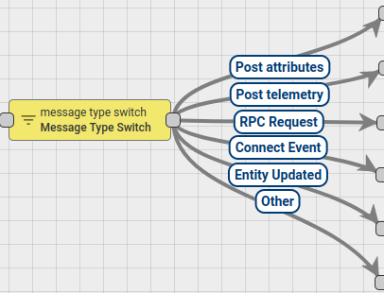
Message Type Switch Node
Route incoming messages by Message Type. If incoming Message has known Message Type then it is sent to the corresponding chain, otherwise, message is sent to Other chain.
If you use Custom Message Types than you can route those messages via Other chain of Message Type Switch Node to the Switch Node or Message Type Filter Node configured with required routing logic.

Slide 24
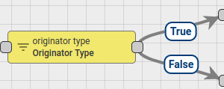
Originator Type Filter Node
In the Node configuration, administrator defines set of allowed Originator Entity types for incoming Message.
If incoming Originator Type is expected - Message is sent via True chain, otherwise False chain is used.

Slide 25
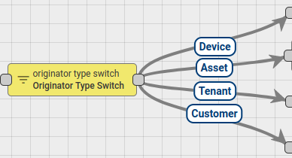
Originator Type Switch Node
Routes incoming messages by Originator Entity type.

Slide 26

Script Filter Node
Evaluates incoming Message with configured JavaScript condition.
JavaScript function receive 3 input parameters:
msg - is a Message payload.
metadata - is a Message metadata.
msgType - is a Message type.
Script should return Boolean value. If True - send Message via True chain, otherwise False chain is used.

Slide 27
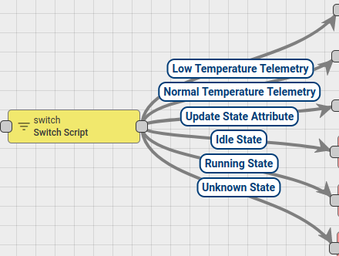
Switch Node
Routes incoming Message to one OR multiple output chains. Node executes configured JavaScript function.
JavaScript function receive 3 input parameters:
msg - is a Message payload.
metadata - is a Message metadata.
msgType - is a Message type.
The script should return an array of next Relation names where Message should be routed. If returned array is empty - message will not be routed to any Node and discarded.

Slide 28
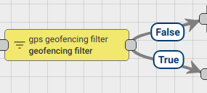
GPS Geofencing Filter Node
Filters incoming messages by GPS based parameters. Extracts latitude and longitude from data or metadata and checks if they are inside configured perimeter (geo fence).
if configured latitude and longitude are inside configured perimeter message sent via True chain, otherwise False chain is used.
Failure chain will to be used when:
incoming message has no configured latitude or longitude key in data or metadata.
missing perimeter definition;

Slide 29
Enrichment Nodes

Slide 30
Enrichment Nodes
Enrichment Nodes are used to update meta-data of the incoming Message.
Customer attributes
Device attributes
Originator attributes
Originator fields
Related attributes
Tenant attributes
Originator telemetry
Tenant details
Customer details

Slide 31
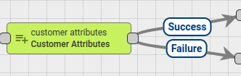
Customer attributes
Node finds Customer of the Message Originator entity and adds Customers Attributes or Latest Telemetry value into Message Metadata.
Administrator can configure the mapping between original attribute name and Metadata attribute name.

Slide 32

Device Attributes
Node finds Related Device of the Message Originator entity using configured query and adds Attributes (client\shared\server scope) and Latest Telemetry value into Message Metadata.
Attributes are added into metadata with scope prefix:
shared attribute -> shared_
client attribute -> cs_
server attribute -> ss_
telemetry -> no prefix used

Slide 33

Originator Attributes
Add Message Originator Attributes (client\shared\server scope) and Latest Telemetry value into Message Metadata.
Attributes are added into metadata with scope prefix:
shared attribute -> shared_
client attribute -> cs_
server attribute -> ss_
telemetry -> no prefix used

Slide 34
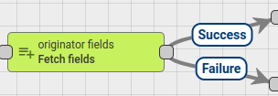
Originator Fields
Node fetches fields values of the Message Originator entity and adds them into Message Metadata. Administrator can configure the mapping between field name and Metadata attribute name. If specified field is not part of Message Originator entity fields it will be ignored.

Slide 35

Related Attributes
Node finds Related Entity of the Message Originator entity using configured query and adds Attributes or Latest Telemetry value into Message Metadata.
Administrator can configure the mapping between original attribute name and Metadata attribute name.
In ‘Relations query’ configuration Administrator can select required Direction and relation depth level. Also set of Relation filters can be configured with required Relation type and Entity Types.

Slide 36

Tenant Attributes
Node finds Tenant of the Message Originator entity and adds Tenant Attributes or Latest Telemetry value into Message Metadata.
Administrator can configure the mapping between original attribute name and Metadata attribute name.

Slide 37
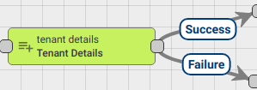
Tenant Details
Rule Node Adds fields from Tenant details to the message body or metadata.
Selected details are added into metadata with prefix: tenant_. Outbound Message will contain configured details if they exist.
To access fetched details in other nodes you can use one of the following template:
metadata.tenant_address
msg.tenant_address
Failure chain is used if Originator does not have assigned Tenant Entity, otherwise - Success chain.

Slide 38
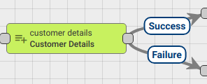
Customer Details
Rule Node Adds fields from Customer details to the message body or metadata.
Selected details are added into metadata with prefix: customer_. Outbound Message will contain configured details if they exist.
To access fetched details in other nodes you can use one of the following template:
metadata.customer_email
msg.customer_email

Slide 39
Transformation Nodes

Slide 40
Transformation Nodes
Transformation Nodes are used for changing incoming Message fields like Originator, Message Type, Payload and Metadata.
Change originator
Script Transformation Node
To Email Node

Slide 41

Change Originator Nodes
This node is used in cases when a submitted message should be processed as a message from another entity. For example, Device submits telemetry and telemetry should be copied into higher level Asset or to a Customer. In this case, Administrator should add this node before Save Timeseries Node.
The originator can be changed to:
Originator’s Customer
Originator’s Tenant
Related Entity that is identified by Relations Query

Slide 42

Script Transformation Nodes
Changes Message payload, Metadata or Message type using configured JavaScript function.
JavaScript function receives 3 input parameters:
msg - is a Message payload.
metadata - is a Message metadata.
msgType - is a Message type.

Slide 43

To Email Node
Transforms message to Email Message by populating email fields using values derived from Message metadata. Set ‘SEND_EMAIL’ output Message type that can be accepted later by Send Email Node.
All email fields can be configured to use values from metadata.

Slide 44
Action Nodes

Slide 45
Action Nodes
Action Nodes execute various actions based on incoming Message.
Create Alarm Node
Clear Alarm Node
Delay Node
Generator Node
Log Node
RPC Call Reply Node
RPC Call Request Node
Save Attributes Node
Save Timeseries Node
Save to Custom Table
Assign To Customer Node
Unassign From Customer Node
Create Relation Node
Delete Relation Node
GPS Geofencing Events Node
Fetch perimeter information from message metadata
Fetch perimeter information from node configuration
Event Types

Slide 46
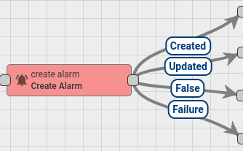
Create Alarm Nodes
This Node tries to load latest Alarm with configured Alarm Type for Message Originator. If Uncleared Alarm exist, then this Alarm will be updated, otherwise a new Alarm will be created.
Node Configuration:
Alarm Details Builder script
Alarm Type - any string that represents Alarm Type
Alarm Severity - {CRITICAL | MAJOR | MINOR | WARNING | INDETERMINATE}
is Propagate - whether Alarm should be propagated to all parent related entities.

Slide 47
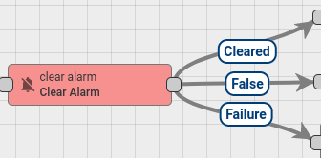
Clear Alarm Nodes
This Node loads the latest Alarm with configured Alarm Type for Message Originator and Clear the Alarm if it exist.
Node Configuration:
Alarm Details Builder script
Alarm Type - any string that represents Alarm Type

Slide 48
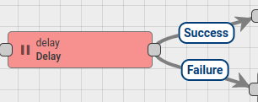
Delay Node
Delays incoming messages for configurable period.
Period in seconds - specifies the value of the period during which incoming message should be suspended
Maximum pending messages - specifies the amount of maximum allowed pending messages (queue of suspended messages)
When delay period for particular incoming message will be reached it will be removed from pending queue and routed to the next nodes via Success chain.
Each next message will be routed via Failure chain if the maximum pending messages limit will be reached.

Slide 49
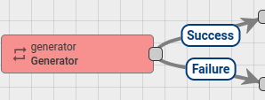
Generator Node
Generates Messages with configurable period. JavaScript function is used for message generation.
Node Configuration:
Message generation frequency in seconds
Message originator
JavaScript function that will generate the actual message.
JavaScript function receive 3 input parameters:
prevMsg - is a previously generated Message payload.
prevMetadata - is a previously generated Message metadata.
prevMsgType - is a previously generated Message type.

Slide 50
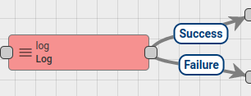
Log Node
Transform incoming Message with configured JavaScript function to String and log final value into the Thingsboard log file.
INFO log level is used for logging.
JavaScript function receive 3 input parameters
metadata - is a Message metadata.
msg - is a Message payload.
msgType - is a Message type.
Script should return String value.

Slide 51
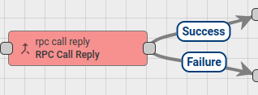
RPC Call Reply Node
Sends response to the RPC Call originator.
All incoming RPC requests are passed through Rule Chain as Messages.
Also all RPC requests have request ID field. It is used for mapping requests and responses.
Message Originator must be a Device entity because RPC response is initiated to the Message Originator.

Slide 52
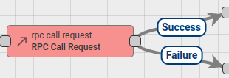
RPC Call Request Node
Sends RPC requests to the Device and routing response to the next Rule nodes. Message Originator must be a Device entity as RPC request can be initiated only to device.
Node configuration has Timeout field used to specify timeout waiting for response from device.

Slide 53
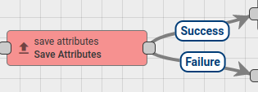
Save Attributes Node
Stores attributes from incoming Message payload to the database and associate them to the Entity, that is identified by the Message Originator. Configured scope is used to identify attributes scope.
Supported scope types:
Client attributes
Shared attributes
Server attributes

Slide 54
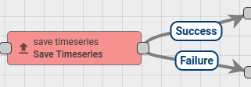
Save Timeseries Node
Stores Timeseries data from incoming Message payload to the database and associate them to the Entity, that is identified by the Message Originator.
Configured TTL seconds is used for timeseries data expiration.

Slide 55
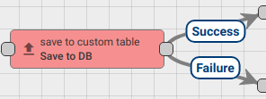
Save to Custom Table
Node stores data from incoming Message payload to the Cassandra database into the predefined custom table that should have cs_tb_ prefix, to avoid the data insertion to the common TB tables.
Please note, that rule node can be used only for Cassandra DB.

Slide 56
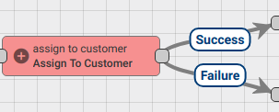
Assign to Customer Node
Assign Message Originator Entity to Customer.
Following Message Originator types are allowed: Asset, Device, Entity View, Dashboard.
Finds target Customer by customer name pattern and then assign Originator Entity to this customer.
Will create new Customer if it doesn’t exists and Create new Customer if not exists is set to true.

Slide 57
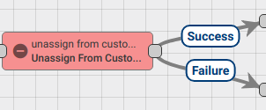
Unassign From Customer Node
Unassign Message Originator Entity from Customer.
Following Message Originator types are allowed: Asset, Device, Entity View, Dashboard.
Finds target Customer by customer name pattern and then unassign Originator Entity from this customer.

Slide 58
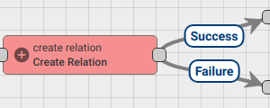
Create Relation Node
Create the relation from the selected entity to originator of the message by type and direction.
Following Message Originator types are allowed: Asset, Device, Entity View, Customer, Tenant, Dashboard.
Finds target Entity by metadata key patterns and then create a relation between Originator Entity and the target entity.
If selected entity type Asset, Device or Customer rule node will create new Entity if it doesn’t exist and selected checkbox: Create new Entity if not exists.
Note: if selected entity type Asset or Device you need to set two patterns:
entity name pattern;
entity type pattern.
Otherwise, only name pattern should be set.

Slide 59
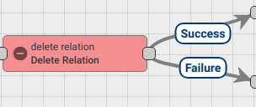
Delete Relation Node
Delete the relation from the selected entity to originator of the message by type and direction.
Following Message Originator types are allowed: Asset, Device, Entity View, Customer, Tenant, Dashboard.
Finds target Entity by entity name pattern and then delete a relation between Originator Entity and this entity.

Slide 60
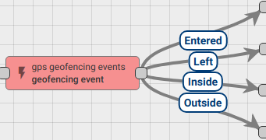
GPS Geofencing Events Node
Produces incoming messages by GPS based parameters. Extracts latitude and longitude from incoming message data or metadata and returns different events based on configuration parameters (geo fence).
There are 4 types of events managed by geofencing rule node:
Entered — is reporting whenever latitude and longitude from the incoming message to belong the required perimeter area for the first time;
Left — is reporting whenever latitude and longitude from the incoming message not belong the required perimeter area for the first time;
Inside and Outside events are used to report current status.

Slide 61
External Nodes

Slide 62
External Nodes
External Nodes used are used to interact with external systems.
AWS SNS Node
AWS SQS Node
Kafka Node
MQTT Node
RabbitMQ Node
REST API Call Node
Send Email Node
Twilio SMS Node → only on Professional Edition

Slide 63
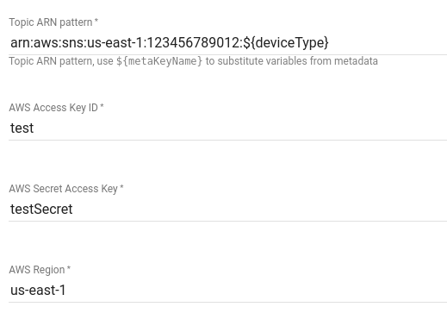
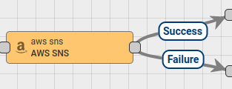
AWS SNS Node
Node publish messages to AWS SNS (Amazon Simple Notification Service).
Configuration:

Slide 64
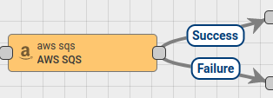
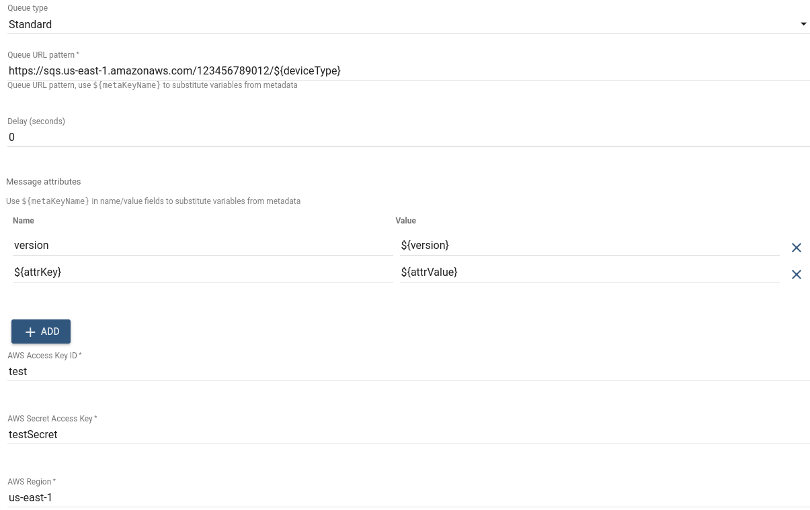
AWS SQS Node
Node publish messages to the AWS SQS (Amazon Simple Queue Service).
Configuration:

Slide 65
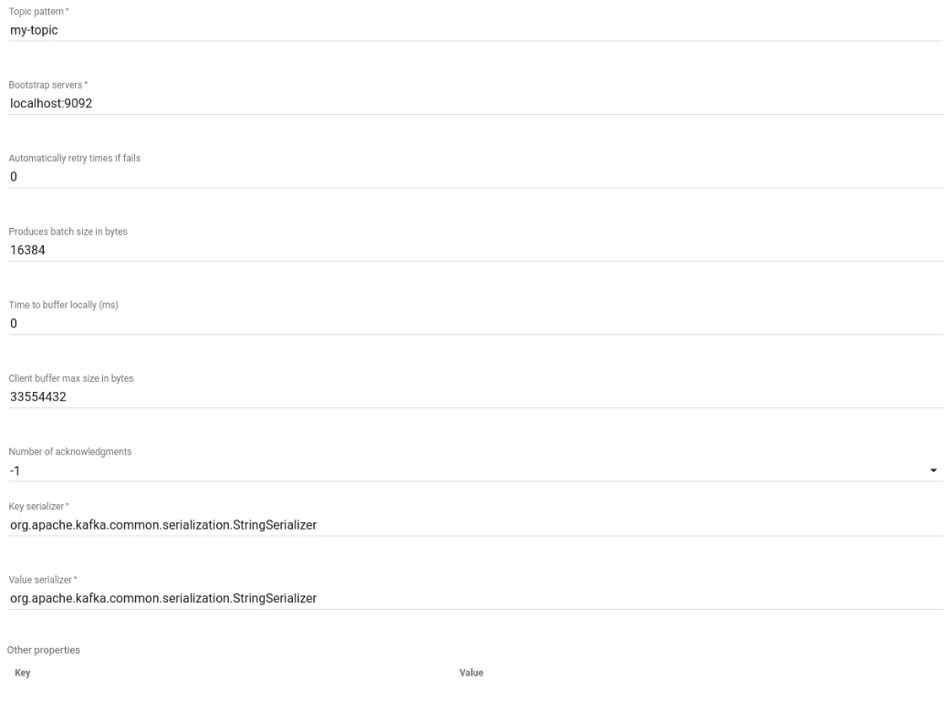
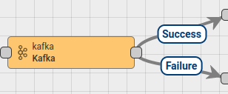
Kafka Node
Kafka Node sends messages to Kafka brokers. Expects messages with any message type. Will send record via Kafka producer to Kafka server.
Configuration:

Slide 66
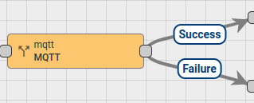
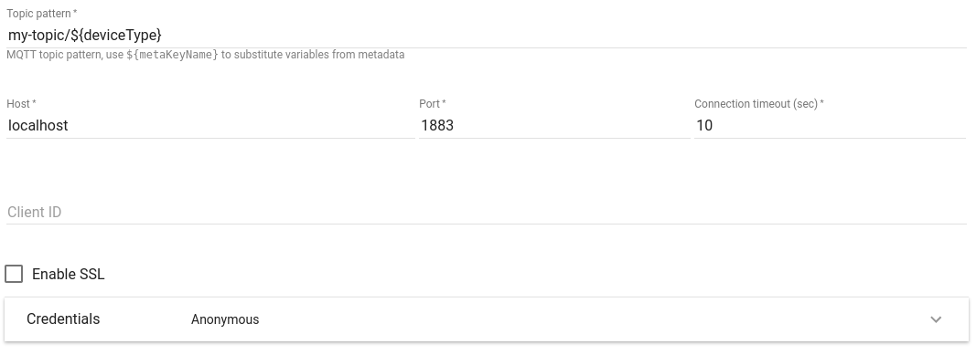
MQTT Node
Publish incoming message payload to the topic of the configured MQTT broker with QoS AT_LEAST_ONCE.
Configuration:

Slide 67
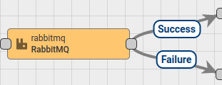
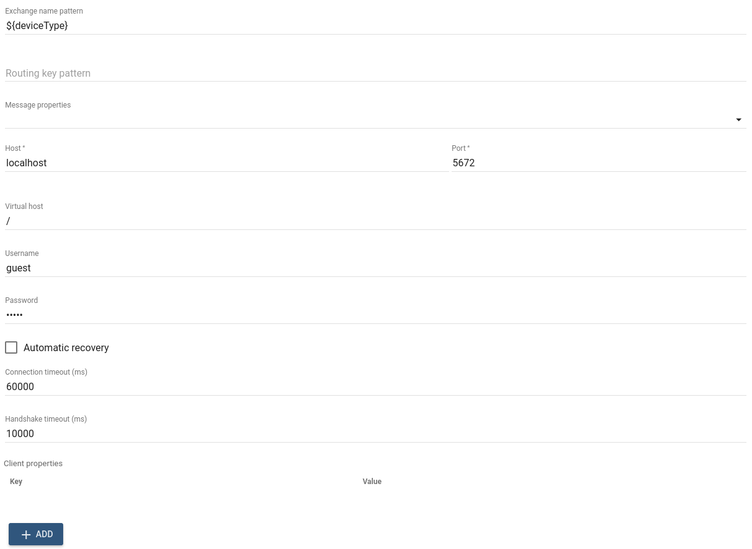
RabbitMQ Node
Publish incoming message payload to the RabbitMQ.
Configuration:

Slide 68
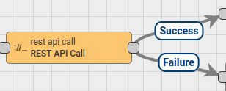
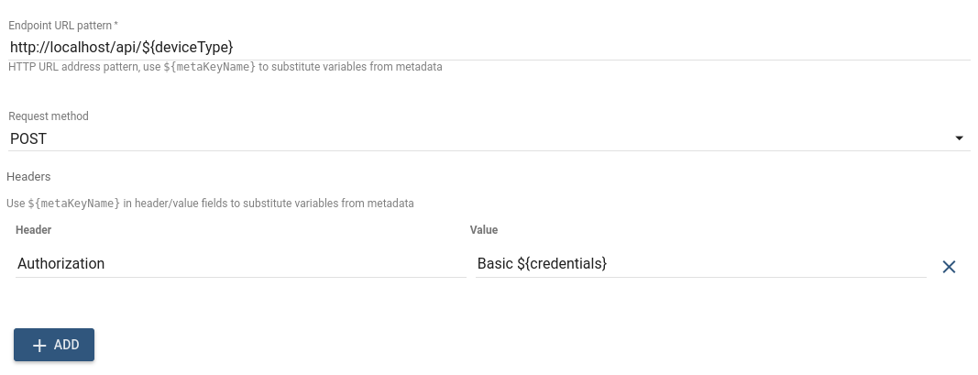
REST API Call Node
Invoke REST API calls to the external REST server.
Configuration:

Slide 69
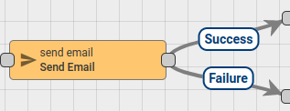
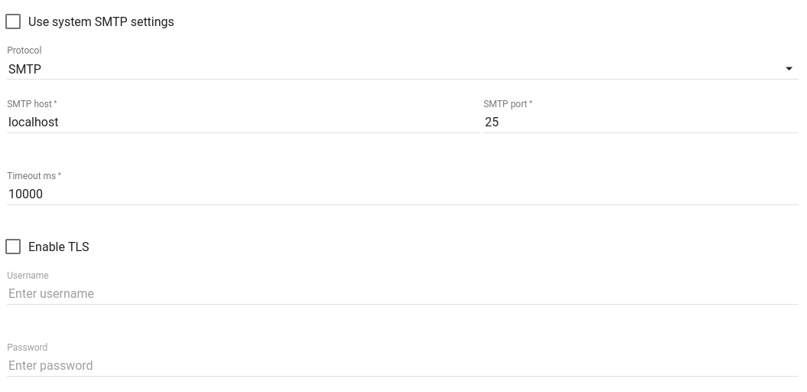
Send Email Node
Node sends incoming message using configured Mail Server. This Node works only with messages that where created using To Emailtransformation Node, please connect this Node with To Email Node using Success chain.
Configuration:

Slide 70
Sesi Praktek
Download curl untuk Windows (untuk testing pengiriman data)
https://curl.haxx.se/windows/
Register ke https://demo.thingsboard.io
Overview tentang Rule Engine
https://thingsboard.io/docs/user-guide/rule-engine-2-0/re-getting-started/
Tutorial dapat dimodifikasi dengan mengirimkan data dari board ESP32

Slide 71
Tutorial 1: Rule Engine
https://www.youtube.com/watch?v=TwJJbxwQX5k
Agar dapat melakukan pengiriman email notifikasi pada Thingsboard, lakukan hal berikut:
Register ke sendgrid.com
Setting sendgrid.com API Key
https://sendgrid.com/docs/ui/account-and-settings/api-keys/
Gunakan API name dan API Key pada node send email di Rule Engine Thingsboard

Slide 72
Tutorial 2: REST API Call
https://thingsboard.io/docs/user-guide/rule-engine-2-0/tutorials/get-weather-using-rest-api-call/

Slide 73





IKUTI KAMI
digitalent.kominfo
digitalent.kominfo
DTS_kominfo
Digital Talent Scholarship 2019
Pusat Pengembangan Profesi dan Sertifikasi
Badan Penelitian dan Pengembangan SDM
Kementerian Komunikasi dan Informatika
Jl. Medan Merdeka Barat No. 9
(Gd. Belakang Lt. 4 - 5)
Jakarta Pusat, 10110
digitalent.kominfo.go.id

